Slide 1
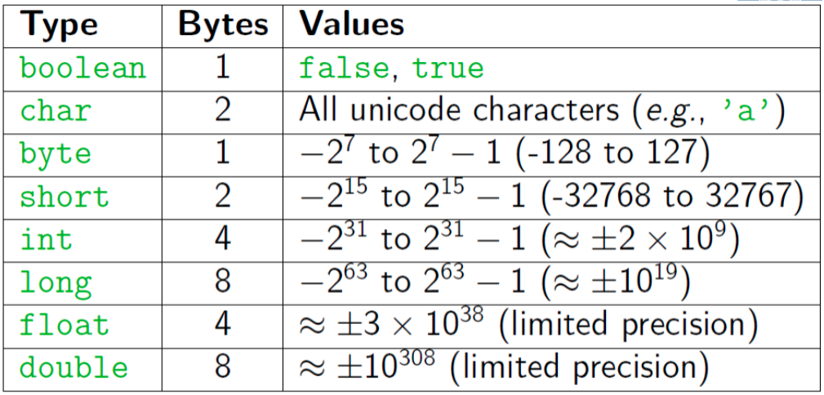
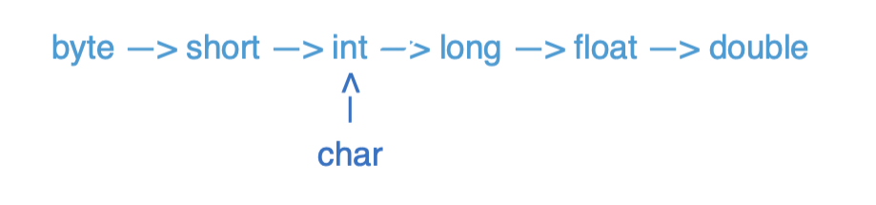
Java Types

Slide 2
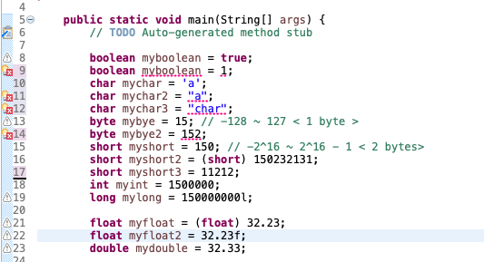
Java Types

Slide 3
Pre/Post Increment/Decrement
Pre-Increment/Decrement
++x/--x: returns the increment/decrement number and x becomes the increment/decrement number
Post-Increment/Decrement
x++/x--: returns the original number and x becomes the increment/decrement number
x == 8
++x == 9
x == 9
x == 4
--x == 3
x == 3
x == 8
x++ == 8
x == 9
x == 4
x-- == 4
x == 3

Slide 4
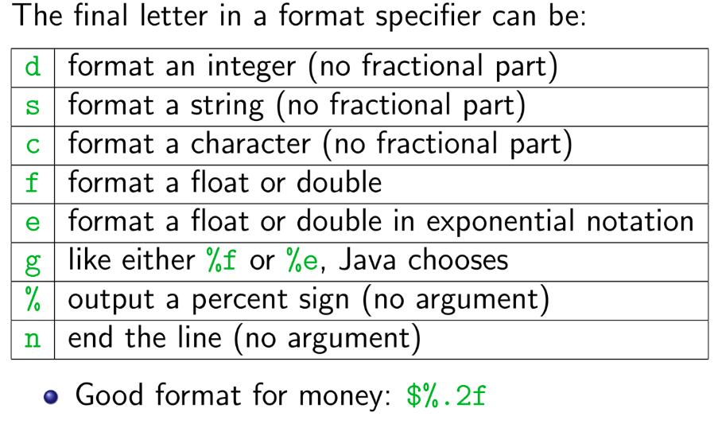
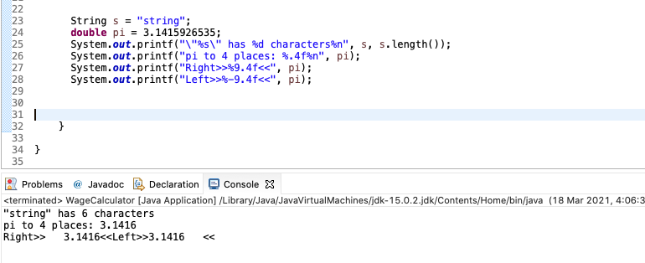
printf
Printf is like print, but it lets you control how data is formatted
Method from System.out.printf(format-string, args)
Example: System.out.printf(“Avarage: %5.2f”, average)
Format String: %X.Y
X is the minimum number of characters to be printed
Y is the number of digits of the value to print after the decimal point

Slide 5
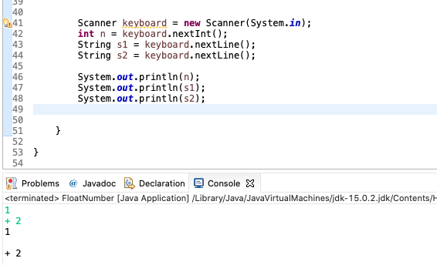
Scanner
Get from Console: Scanner keyboard = new Scanner(System.in);
Get from File: File text = new File("C:/temp/test.txt");
Scanner scanner = new Scanner(text);
.nextLine() reads the rest of the whole line as string
.next()/ .nextInt() / .nextDouble() reads until whitespace

Slide 6
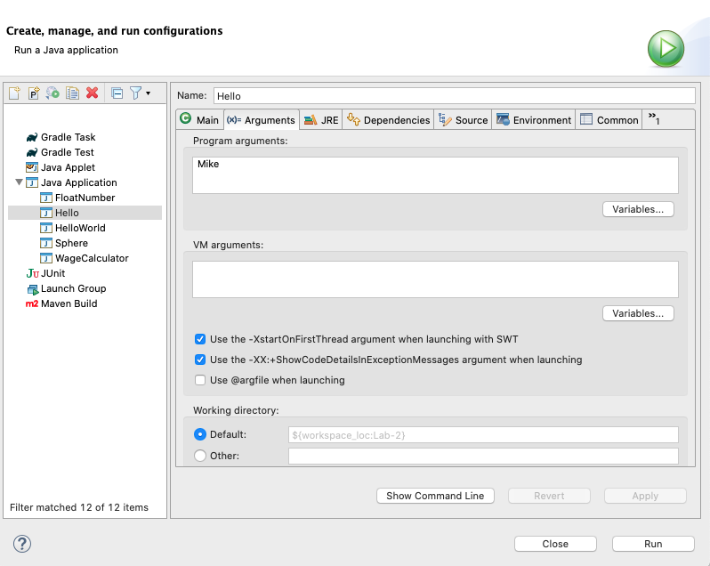
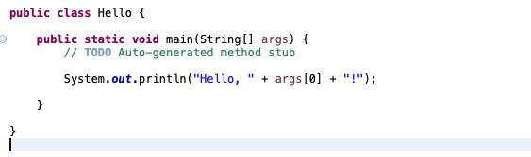
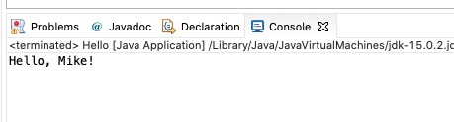
Command Line inputs/arguments
First argument: args[0], second argument: args[1]
Each of these arguments is a string (need to convert to other types for use)

Slide 7
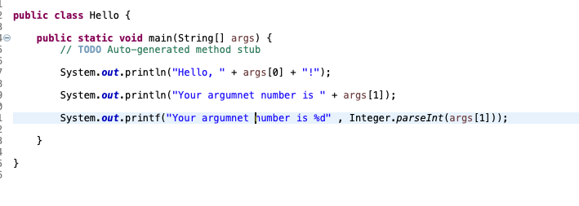
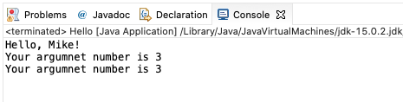
Command Line inputs/arguments
Convert to int
Integer.parseInt(String)

Slide 8
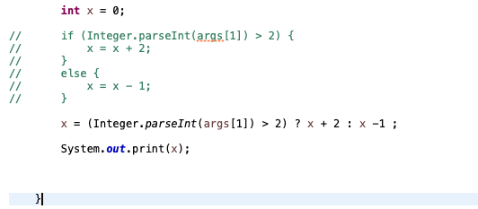
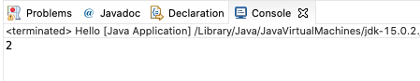
Conditional Operator
Alternative for if-else statement

Slide 9
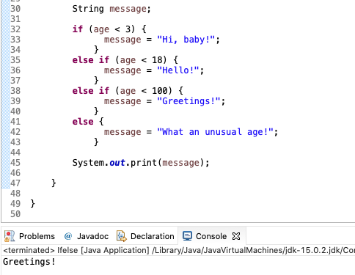
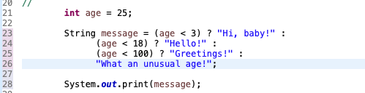
Conditional Operator
If - else if – else statement VS Conditional Operator

Slide 10
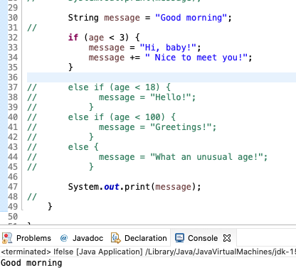
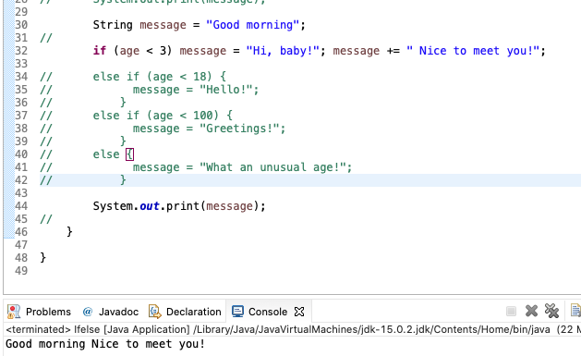
Compound statement
Turns multiple statements into a single statement that can be used in an if.
A good suggestion: Always use braces!
Always use indentation to make your code easy to read

Slide 11
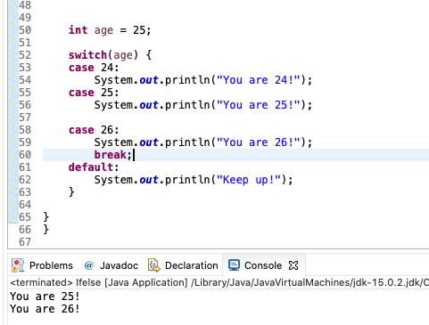
Switch
It begins executing with the next statement and stops when it reaches a break or end of the switch.
Always put break after each statement including default

Slide 12
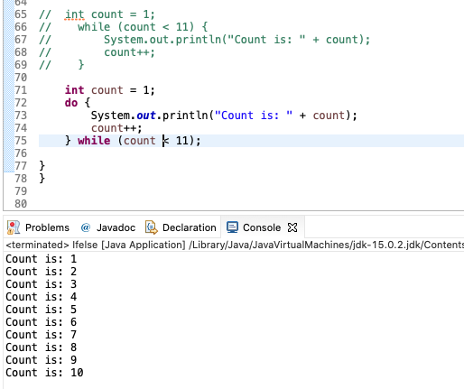
While VS do-while
While
entry control loop
condition is checked before loop execution
never execute loop if condition is false
there is no semicolon at the end of while statement
Do-While
exit control loop
condition is checked at the end of loop
executes false condition at least once since condition is checked later
there is semicolon at the end of while statement.

Slide 13
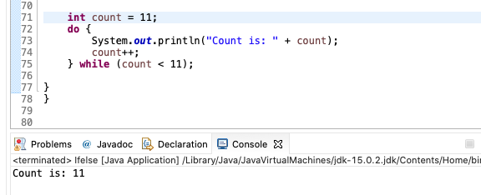
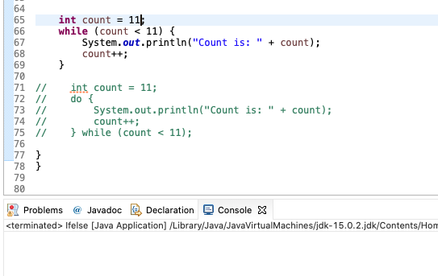
While VS do-while

Slide 14
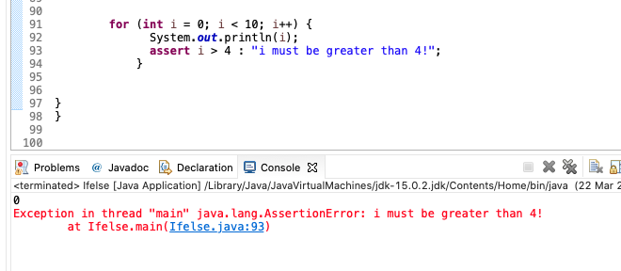
Assert
Check for some must meet condition!
Not common use
Enable Asset in Eclipse

Slide 15
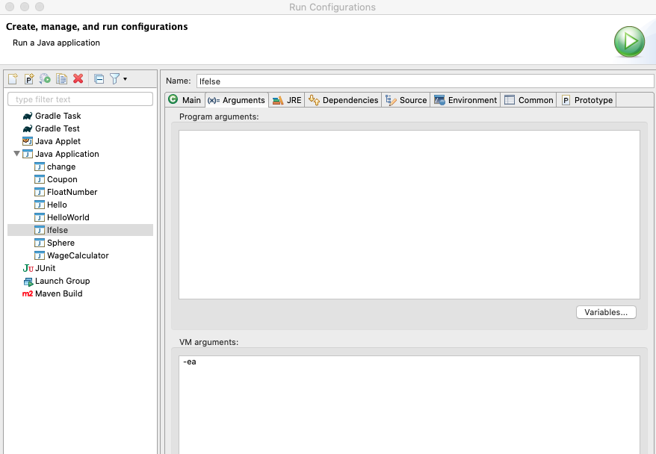
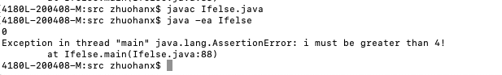
Assert
Check for some must meet condition!
Not common use
Enable Asset in Eclipse or Terminal

Slide 16
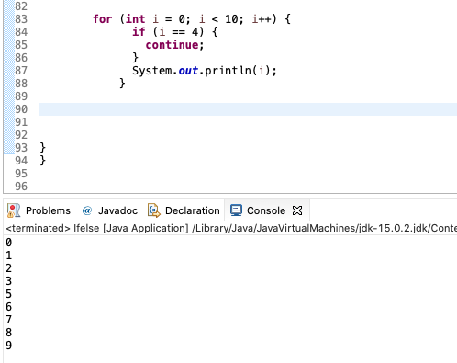
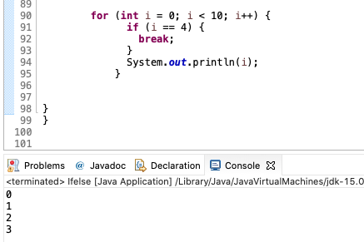
Continue VS Break
Continue passes one iteration; break breaks out of the whole loop

Slide 17
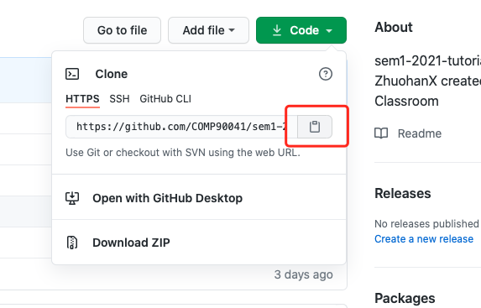
Git Clone a repository
Copy the link!

Slide 18
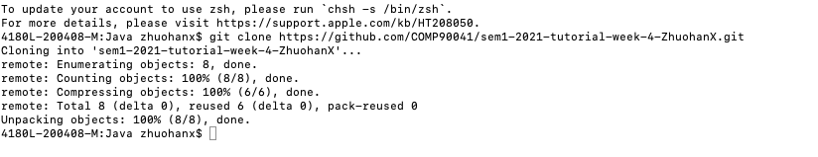
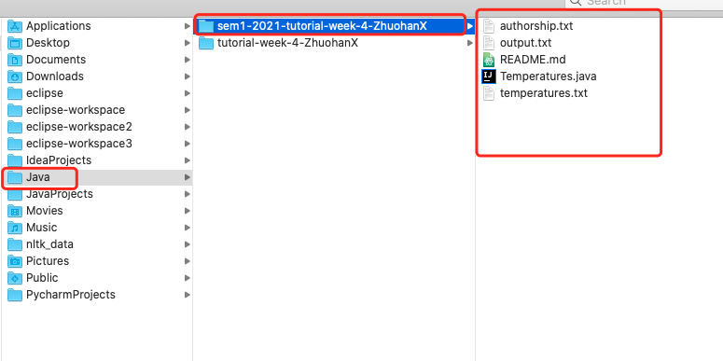
Git Clone a repository
Open a terminal at the suitable location and use git clone (link)

Slide 19
Import from File System and Edit Your Code

Slide 20
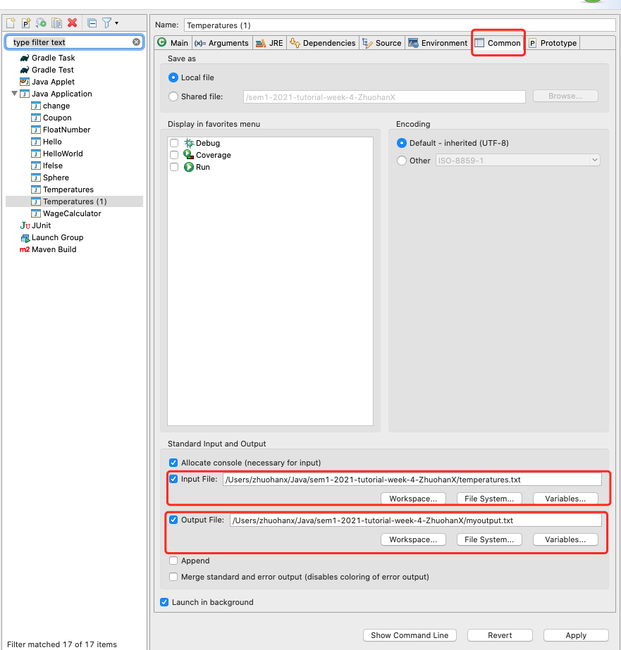
Run code with file input and output
Eclipse: Run configuration > Common > Input File and Output File.
Terminal : Java (Class) < (input file) > (output file)
Command can be separated (use only input or output)

Slide 21
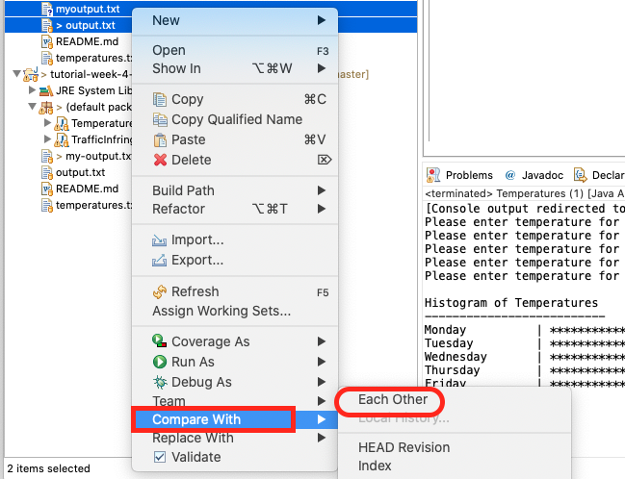
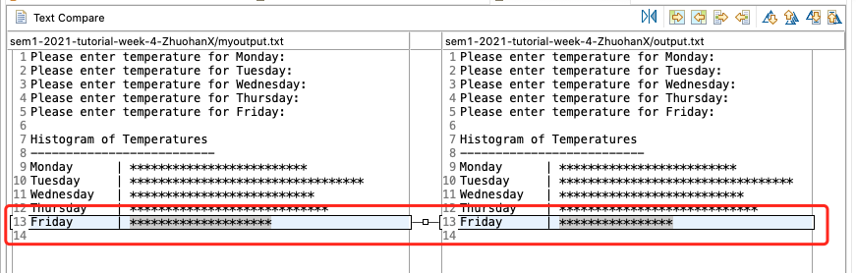
Compare the Differences
Eclipse: Select two files and use compare with each other

Slide 22
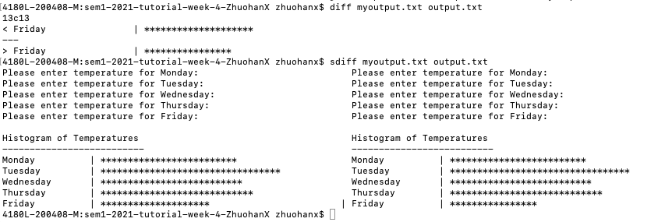
Compare the Differences
Terminal command: sdiff and diff

Slide 23
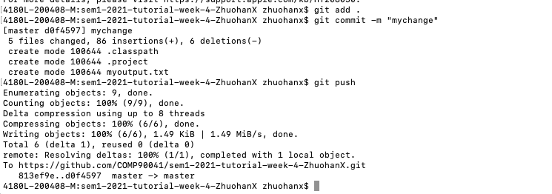
Commit code change and push
Add all your changed code files (. Means all)
Commit with commit message (for yourself to check)
Push to the remote repostitory

Slide 24
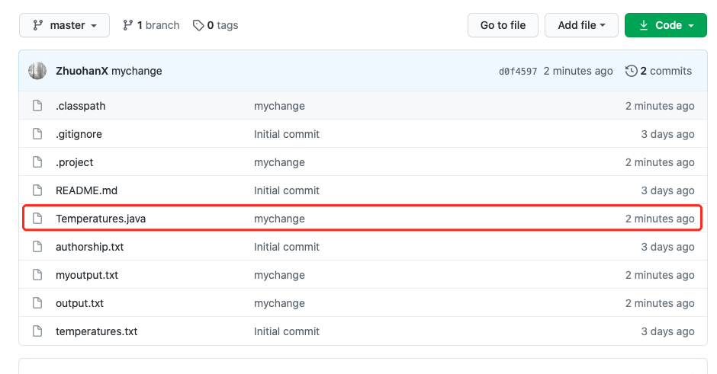
Commit code change and push
Updated file shows message and time!

Slide 25
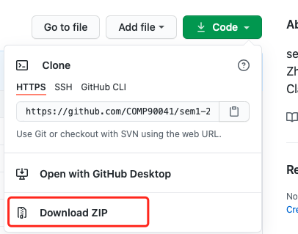
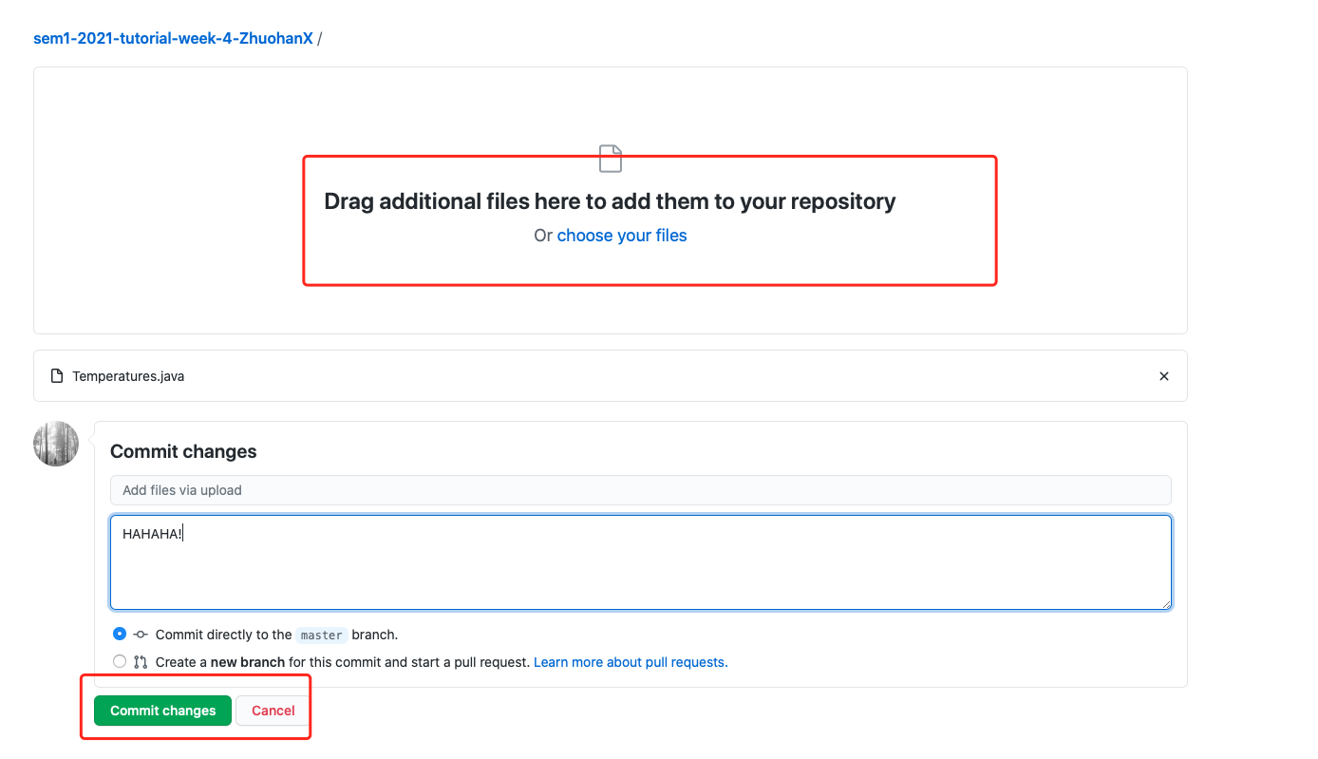
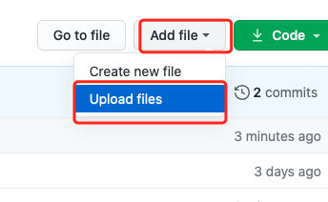
Do everything on Website
Download Code and Edit and drag your files and commit on webpage.

Slide 26
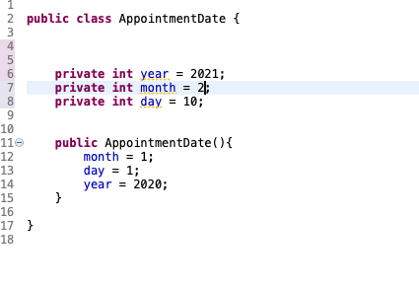
Classes and Methods
A Java program consists of objects from various classes interacting with one another
Every program is a class
Class is a type that you can declare variables of a class type
Object or instance of the class is the value of a class type
Car mycar = new Car();
Object has both data and actions (methods).
All objects of the same class might have different data value, but the same data type and methods.
A primitive type value is a single piece of data
A class type object can have multiple pieces of data and methods.

Slide 27
Methods
Method consists of a heading and a method body
Methods are invoked using the name of the calling object or class name and the method name
Class.method(); or classvar.method();
Method can compute and return a type value or just perform an action and no return (void method)
A program in Java is a class that contains a main method (a void method)
public static void main(String[] args)

Slide 28
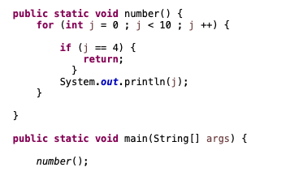
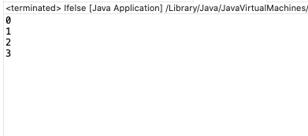
return
The body of a method that returns a value must contain one or more return statements
A return statement specifies the value returned and ends the method invocation: return Expressions;
A void method need not contain a return statement but can use return to end the code.

Slide 29
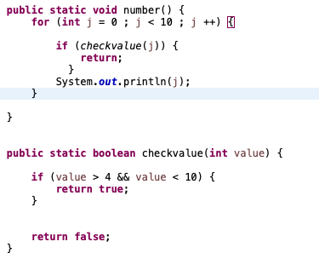
Use returned value
A invocation of a method that returns a value can be used anyplace that a value of the RetrunedType can be used.
An invocation of a method that returns a value of type boolean returns either true or false, usually used in if-else statement or while loops.

Slide 30
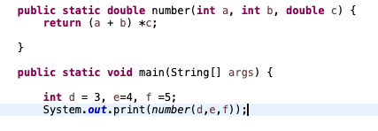
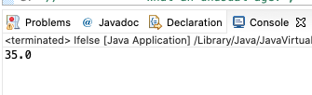
Parameter and argument
A parameter list provides a description of the data required by a method
It indicates the number and types of data pieces needed, the order they must be given and the local name for these pieces as used in the method
Argument is the appropriate values passed to the method (Actual parameters)
The number and order of arguments must exactly match that of the parameter list
If types do not match, Java will try to make an automatic type conversion
call-by-value: value of each argument is passed into the method parameter not name

Slide 31
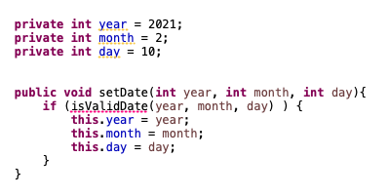
this
this parameter is a hidden parameter
this must be used if local variables have the same name with the instance variables, otherwise all variables will be interpreted as local

Slide 32
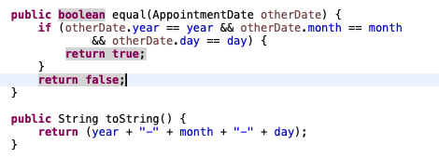
equal and toString
Java expects certain methods such as equal and toString
equal is to compare if the two objects of the class type are the same
toString can be used to display the value of the object

Slide 33
Testing methods
Driver program: A program with only purpose to test a method
Bottom-up testing: For some method that invokes other methods, First test all methods it invokes and then test such method

Slide 34
Information hiding and Encapsulation
Information hiding is the practice of separating how to use a class from the details of its implementation
Abstraction is another term used to express the concept of discarding details in order to avoid information overload
Encapsulation means that the data and methods of a class are combined into a single unit (i.e., a class object), which hides the implementation details
The API or application programming interface for a class is a description of how to use the class
An ADT or abstract data type is a data type that is written using good information-hiding techniques

Slide 35
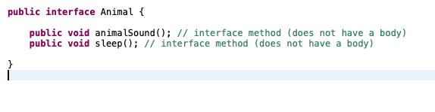
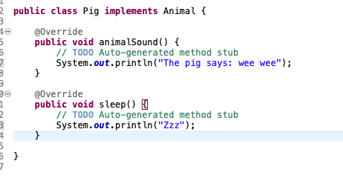
Interface

Slide 36
public and private
public means that there are no restrictions on where an instance variable or method can be used
private means that an instance variable or method cannot be accessed by name outside of the class
It is considered good programming practice to make all instance variables private
Most methods are public, and thus provide controlled access to the object
Usually, methods are private only if used as helping methods for other methods in the class

Slide 37
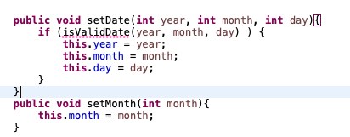
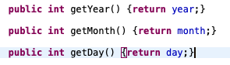
Accessor and Mutator
Accessor methods allow the programmer to obtain the value of an object's instance variables (getter)
Mutator methods allow the programmer to change the value of an object's instance variables in a controlled manner (setter)

Slide 38
Overloading
Overloading is when two or more methods in the same class have the same method name
A signature consists of the name of a method together with its parameter list (not include the returned type)
To be valid, any two definitions of the method name must have different signatures
Java does not permit methods with the same name and different return types in the same class

Slide 39


Overloading

Slide 40
Constructor
Constructor is a special kind of method that is designed to initialize the instance variables for an object
A constructor must have the same name as the class
A constructor has no type returned, not even void
Constructors are typically overloaded
A constructor is called when an object of the class is created using new

Slide 41

Constructor

Slide 42
static methods and variables
A static method can be used without a calling object, need to use the keyword static
public static returnedType MethodName(parameters…)
A static method is invoked using the classname.methodname()
A static method has no this inside the method, so it cannot refer to an instance variable of the class or invoke a non-static method of the class, but it can invoke another static method
A static variable is a variable that belongs to the class as a whole, not just to one object.
Only one copy of a static variable per class, unlike instance variable where each object has its own copy
All objects of the class can read and change a static variable
Static method can access a static variable
Math class has a lot methods you can call using Math.methodnames()

Slide 43
Wrapper classes for primitive types
Wrapper classes provide a class type corresponding to each of the primitive types and makes it possible to have class types that behave somewhat like primitive types.
Boxing: go from a primitive type to an object of its wrapper class
Unboxing: go from an object of wrapper class to the corresponding value of a primitive type
Boxing: Integer integerObject = new Integer(2);
Unboxing: int i = integerObject.intValue();

Slide 44
Wrapper classes for primitive types
Wrapper classes provide a class type corresponding to each of the primitive types and makes it possible to have class types that behave somewhat like primitive types.
Boxing: go from a primitive type to an object of its wrapper class
Unboxing: go from an object of wrapper class to the corresponding value of a primitive type
Boxing: Integer integerObject = new Integer(2);
Unboxing: int i = integerObject.intValue();

Slide 45
Variables and Memory
Second memory is used to hold files for “permanent” storage
Main memory (primary memory) is used by the computer when running a program
Values in a program are kept in main memory
Main memory consists of a long list of numbered locations called bytes
Address: the number that identifies a byte
Values of most data types require more than one byte of storage and the
Address of the first byte of this memory location is used as the address for the data
When the variable is a primitive type, the value of the variable is stored in the memory location, each primitive type always require the same amount of memory to store its values
When the variable is a class type, only the memory address (or reference) where the object is located is stored in the memory location

Slide 46


Slide 47
Class Assignment and Parameters
Two reference variables can contain the same reference, assignment sets the reference to the same object
variable1 = variable2;
A method cannot change the value of a variable of a primitive type that is an argument to the method
In contrast, a method can change the values of the instance variables of a class type that is an argument to the method.
== operator checks that two class type variables have the same memory address
equals checks two class type variables have the same data values (often write by yourself)
null is a ”placeholder” for a reference that does not name any memory location, it is like a memory address, use == or != not equals

Slide 48




Slide 49
Immutable and mutable Class
A class that contains no methods (other than constructors) that change any of the data in an object of the class is called an immutable class (String class is an immutable class)
Objects of such classes are called immutable objects
A class that contains public mutator methods or other public methods that can change the data in its objects is called a mutable class
Objects of which are mutable objects

Slide 50
Deep and Shallow Copy
A copy constructor is a constructor with a single argument of the same type as the class
A deep copy of an object is a copy that with one exception has no references in common with the original. Exception: References to immutable objects
Any copy that is not a deep copy is called a shallow copy
Privacy leak: Shallow Copy without create a new instance variable for mutable class or return a mutable object can cause privacy leak. The values can be changed by others

Slide 51
Arrays
An array that behaves like this collection of variables, all of type double, can be created using one statement as follows:
double[] score = new double[5];
Use index score[0], score[1], score[2], score[3], score[4] to get the number 1, 2, 3, 4, 5 of the element.
An array is declared and created in almost the same way that objects are declared and created
BaseType[] ArrayName = new BaseType[size];
Usually use a for loop to go through an array.
Array is an object and has an instance variable: length.
score.length is 5.
Index is from 0 to length-1, other indexs would cause an out-of-bounds error.
Initialize with declare: int[] age = {2, 12, 1} (age.length is 3)
Or initialize with a for loop
If not initialized, they will automatically be initialized to the default value for their base type

Slide 52

Arrays

Slide 53
Arrays and Reference
Arrays are objects
A variable of an array type holds the address of where the array object is stored in memory
Since an array is a reference type, the behavior of arrays with respect to assignment (=), equality testing (==), and parameter passing are the same as that described for classes
the assignment operator (=) copies this memory address
the equality operator (==) tests two arrays share the same address, not values.
Need to write methods to check length and each values to check if they are equal.
The heading for the main method of a program has a parameter for an array of String
You can return an array in the method.
Date[] holidayList = new Date[20];
Each of these indexed variables are automatically initialized to null
for (int i=0; i<holidayList.length; i++) { holidayList[i] = new Date(); }
Both array indexed variables and entire arrays can be used as arguments to methods

Slide 54

Arrays and Reference

Slide 55




Arrays and Reference

Slide 56
Command Line inputs/arguments
First argument: args[0], second argument: args[1]
Each of these arguments is a string (need to convert to other types for use)

Slide 57




Arrays and Reference

Slide 58




for-each loop to go through array

Slide 59


Avoid privacy leak for array
Array is a mutable object, don’t give an array directly, but create a new one and copy all values.

Slide 60

Selection Sort in Array

Slide 61

Selection Sort in Array

Slide 62


Selection Sort in Array

Slide 63


Enumerated Type
Work likes String but one variable can only be set to within the fixed items. Perfectly fit with switch

Slide 64


ArrayList
An object that can works like array, but change length and less effeciently.
The class ArrayList is implemented using an array as a private instance variable – When this hidden array is full, a new larger hidden array is created and the data is transferred to this new array
An ArrayList is less efficient than an array It does not have the convenient square bracket notation The base type of an ArrayList must be a class type or interface type (or other reference type): it cannot be a primitive type
ArrayList come with many powerful methods you can use.

Slide 65
Multidimendional Arrays
Multidimensional arrays are declared and created in the same ways as one-dimensional arrays.
double[][]table = new double[100][10];
int[][][] figure = new int[10][20][30];
Person[][] = new Person[10][100];
Two-dimensional array is array of arrays
char[][] page = new char[30][100];
page.length is equal to 30
page[0].length is equal to 100
Ragged array: an array that has a
different number of elements per row

Slide 66

Multidimendional Arrays

Slide 67

Multidimendional Arrays

Slide 68


Multidimendional Arrays

